Slide 1
Iterative and evolutionary development
Iterative and evolutionary development
Not sequential/waterfall
It involves early programming and testing of a partial system in repeating cycles
It assumes development starts before all the requirements are defined in detail
Feedback is used to clarify and improve the evolving specifications.

Slide 2
Unified process –is a software development process for building OO systems.
It combines commonly accepted practices like an iterative lifecycle and risk driven development into cohesive and well documented description.
This process is used to introduce OOAD.
IT helps to tell about how to do and how to learn OOAD
Best practice used in UP is iterative development
In this approach the ,development is organized into a series of short,fixed –length mini projects called iterations.

Slide 3
The outcome of each is tested,integrated and executable system.
Each iteration includes its own requirement analysis ,design,implementation and testing activities.
Iterations are timeboxed.

Slide 4
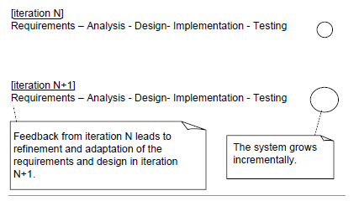
Iterative Development

Slide 5
Iterative Development is successively enlarging and refining a system through multiple iterations, using feedback and adaptation.
Thus the system grows incrementally over time ,iteration by iteration and thus this approach is known as iterative and incremental development/Evolutionary development(because feedback and adaptation evolve the specifications and design)

Slide 6
IT is not a throw away prototype or not an experimental
Output is a production grade subset of the final system

Slide 7
Each iteration involves choosing a small subset of the requirements and quickly designing ,implementing and testing.
Get the feedback from users,developers and tests(load and usability tests)
End user can also see the partial system and give comments

Slide 8
Better to resolve and prove the risky and critical design decisions early
Time boxed or fixed in length

Slide 9
BENEFITS OF ITERATIVE DEVELOPMENT
Early rather than late mitigation of high risks
Early visible progress
Early feedback, user engagement and adaptation leading to develop refined system
Managed complexity
Learning with iteration improves the development process

Slide 10
Unified Process best practices
Get high risk and high value first
Constant user feedback and engagement
Early cohesive core architecture
Test early, often, and realistically
Apply use cases where needed
Do some visual modeling with UML
Manage requirements
Manage change requests and configuration

Slide 11
UP is divided into four phases, named:
Inception
Elaboration
Construction
Transition

Slide 12
Inception - Define the scope of project.
Elaboration - Plan project, specify features, baseline architecture.
Construction - Build the product
Transition - Transition the product into end user community

Slide 13
Inception –approximate vision, business case, scope ,vague estimates
Not requirement phase, checking for feasibility (proceed or not)
Elaboration-refined vision, iterative implementation of the core architecture ,resolution of high risks, identification of most requirements and scope ,more realistic estimates

Slide 14
Construction
Iterative implementation of the remaining lower risk and easier elements and preparation for deployment.
Transition
Beta tests, deployment

Slide 15
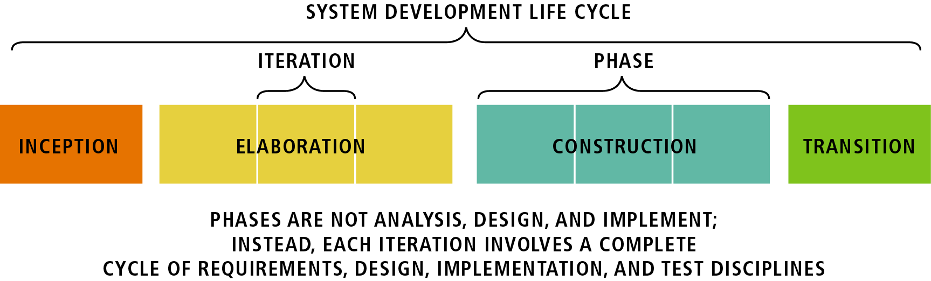
Inception –not a requirement phase: It is a feasibility phase :Investigation is done to support a decision to continue or stop
Elaboration –not requirement or design phase:
It is a phase where the core architecture is iteratively implemented and high risk issues are mitigated.
Construction: continue design and implementation
Transition: move the system into operational mode

Slide 16
artifact
Any work product
Code
Web graphics
Db schema
Text document
Diagrams
models

